Slide 1
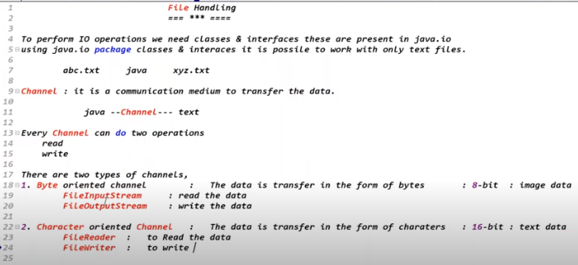

Slide 2


Slide 3
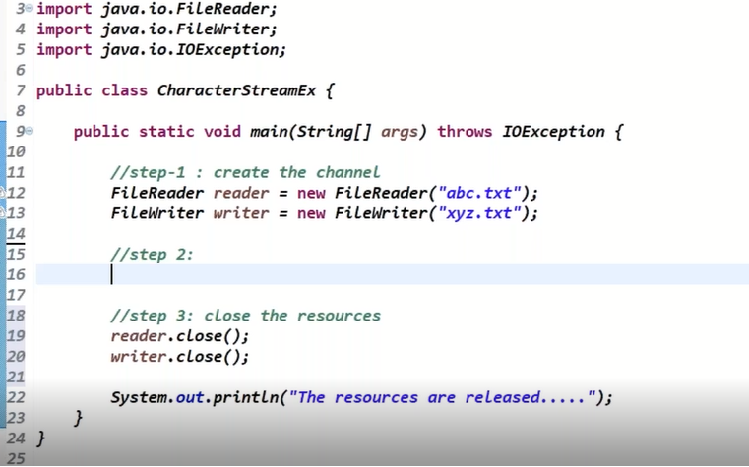

Slide 5
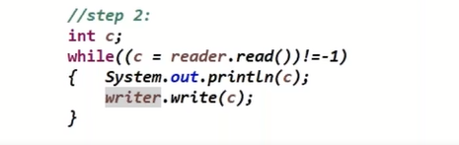
Reading and Writing of Data

Slide 6
To read the data file is mandatory, but for writing the data the file is optional.

Slide 7
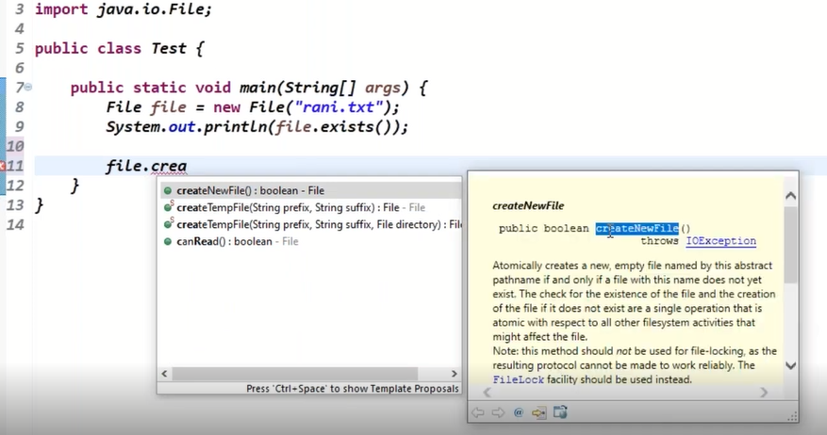
Creating an Empty Txt file

Slide 8
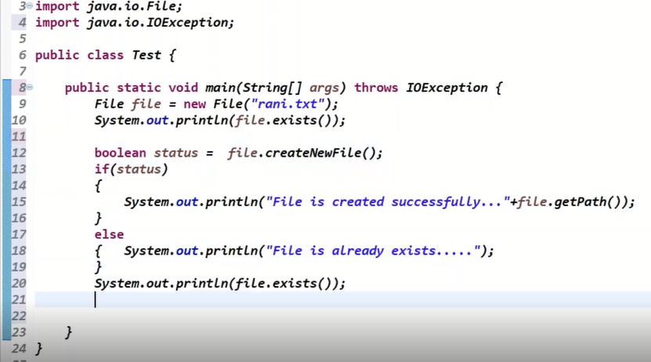
Creating a file

Slide 9
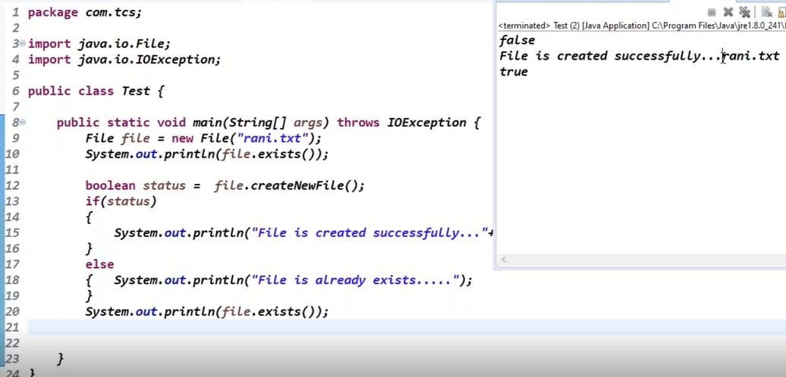

Slide 10
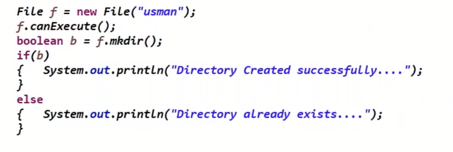
Creating a Directory

Slide 11

Creating a File inside a Directory

Slide 12
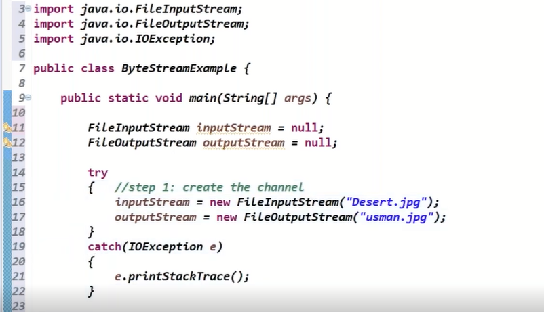

Slide 13
To release the resources we need finally block

Slide 14
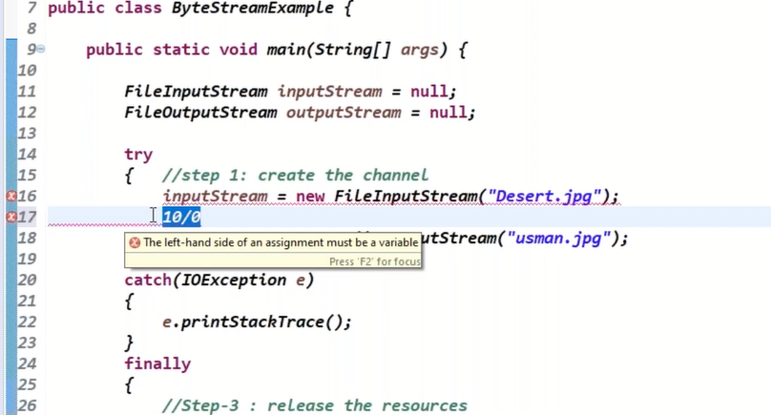
The Outputstream object is not created but we try to close the outputstream

Slide 15
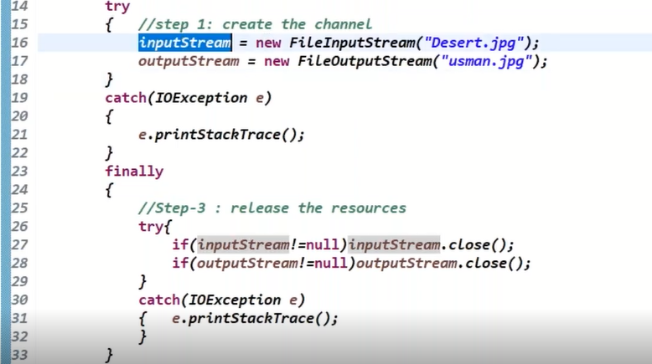

Slide 16
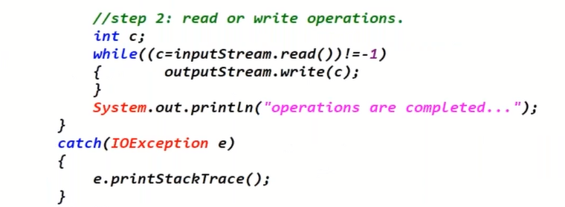
Read Write Operations

Slide 17


